Slide 1
Project: Instagram User Analytics
By: Prashant Kumar
Data Analytics Trainee

Slide 2
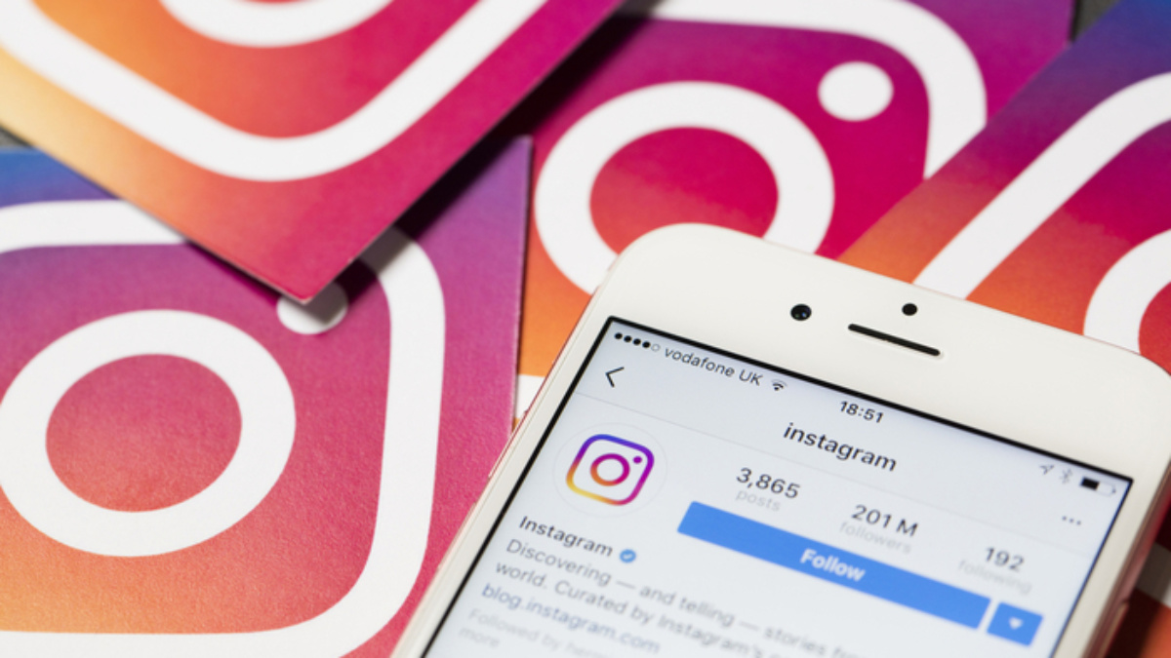
Project Description
This project involves analyzing user behavior and engagement on Instagram through SQL. By providing insights and answers to questions posed by the marketing and investor teams, the project aims to help the business grow and make informed decisions.

Slide 3

Approach
Created a SQL database with tables for users, photos, comments, likes, follows, tags and associations.
Used SQL queries to extract information for each question asked by marketing team and investor teams.

Slide 4


Tech-Stack Used
The software used for this project was MySQL version 8.0.26 and SQL queries were executed using MySQL Workbench.
MySQL was chosen as the database management system due to its reliability, ease of use, and compatibility with SQL.
MySQL Workbench was used as the query editor to execute SQL queries on the database.

Slide 5

Insights
During the project, I gained insights into the user behavior on Instagram and the key metrics that are important for measuring the app's success.

Slide 6
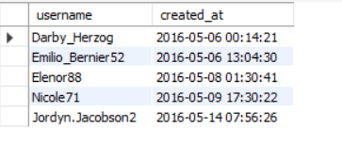
A)Marketing:
1.Rewarding Most Loyal Users:
People who have been using the platform for the longest time.
QUERY:
*/5 oldest users of the Instagram from the database provided*/
SELECT username, created_at
FROM users
ORDER BY created_at ASC
LIMIT 5;

Slide 7
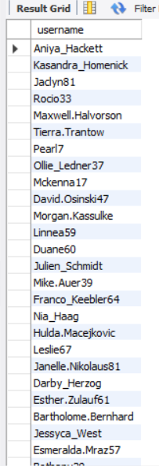
2.Remind Inactive Users to Start Posting:
Users who have never posted a single photo on Instagram
QUERY:
SELECT username
FROM users
LEFT JOIN photos ON users.id = photos.user_id
WHERE photos.id IS NULL;

Slide 8
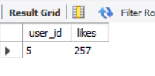
3.Declaring Contest Winner:
User who gets the most likes on a single photo will win the contest.
QUERY:
/*winner of the contest*/
SELECT user_id, COUNT(*) AS likes
FROM likes
GROUP BY user_id
ORDER BY likes DESC
LIMIT 1;

Slide 9
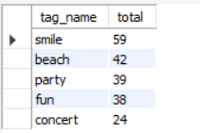
4.Hashtag Researching:
Top 5 most commonly used hashtags on the platform
QUERY:
SELECT tag_name,
count(tag_name) AS total
FROM tags
JOIN photo_tags
ON tags.id=photo_tags.tag_id
GROUP BY tags.id
ORDER BY total DESC
LIMIT 5;

Slide 10
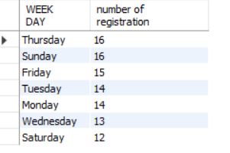
5.Launch AD Campaign:
Provide insights on when to schedule an ad campaign.
QUERY:
/*day of the week do most users register on?*/
SELECT date_format(created_at,'%W') AS 'WEEK DAY',
count(*) AS 'number of registration'
FROM users
GROUP BY 1
ORDER BY 2 DESC;

Slide 11



B) Investor Metrics:
1.User Engagement: Provide how many times does average user posts on Instagram. Also, provide the total number of photos on Instagram/total number of users
QUERY:
-- average user posts on Instagram
SELECT COUNT(*) / (SELECT COUNT(*) FROM users) AS avg_photos_per_user
FROM photos;
-- total number of photos on Instagram
SELECT COUNT(*) as total_photos
FROM photos;
-- total number of users
SELECT COUNT(*) AS total_users FROM users;

Slide 12
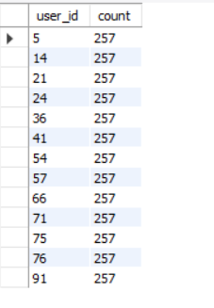
2.Bots & Fake Accounts: Provide data on users (bots) who have liked every single photo on the site .
QUERY:
/*data on users (bots) who have liked every single photo on the site*/
SELECT user_id, COUNT(*) AS count
FROM likes
GROUP BY user_id
HAVING count = (SELECT COUNT(*) FROM photos)

Slide 13

Result
The project has helped in providing useful insights into the user behavior and engagement on the Instagram platform. The marketing and investor teams can use this information to make informed decisions for the growth of the business.

